Slide 1
CHEM 102
SECTION B
SOLID STATE II
SUBTOPIC: DESIGNATION OF LATTICE PLANES

Slide 2
Fundamental Crystallographic terms
Lattice is defined as an array of points which are imaginarily kept to represent the position of atoms in the crystal that every lattice point has got the same environment as that o the other and hence one lattice point cannot be distinguished from the other lattice point.
Space Lattice or Crystal Lattice is a three dimensional collection of points in space. The environment about any particular point is in everyway the same.
The regular pattern of points which describe the three dimensional arrangement of particles in a crystal structure is called the Crystal Lattice or Space lattice.
Basis is formed by associating with every lattice point a uint of assembly of atoms or molecules identical in composition. This unit assembly is called Basis.
The Crystal Structure is formed by the addition of a basis to every lattice point.

Slide 3
CRYSTAL PLANE DESIGNATION
There are two methods to designate the crystal planes:
USE OF WEISS INDICES
USE OF MILLER INDICES

Slide 4
Weiss indices
The Weiss parameters, introduced by Christian Samuel Weiss in 1817, are the ancestors of the Miller indices.
They give an approximate indication of a face orientation with respect to the crystallographic axes, and were used as a symbol for the face.

Slide 5
Miller indices
Definition of Miller index
Any of a set of three numbers or letters used to indicate the position of a face or internal plane of a crystal and determined on the basis of the reciprocal of the intercept of the face or plane on the crystallographic axes.
Miller Indices are a symbolic vector representation for the orientation of an atomic plane in a crystal lattice and are defined as the reciprocals of the fractional intercepts which the plane makes with the crystallographic axes.

Slide 6
PROCEDURE FOR FINDING MILLER INDICES
Miller introduced a system to designate a plane in a crystal. He introduced a set of three numbers to specify a plane a plane in a crystal.
This set of three numbers is known as Miller Indices of the concerned plane.
1) Determine the intercepts of the plane along the axes X, Y and Z in terms of the Lattice Constant a, b, c.
2) Determine the reciprocals of these numbers.
3) Find the least common denominator (LCD) and multiply each by this lcd.
4) The result is written in the form (hkl) and is called the Miller Indices of the plane.

Slide 7
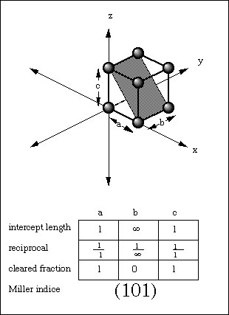
Why MILLER INDICES
(101)
In this case the plane intercepts the a axis at one unit length and also the c axis at one unit length. The plane however, never intersects the b axis. TRY TO CORRELATE WITH THE FIGURE.
In other words, it can be said that the intercept to the b axis is infinity. The intercepts are then designated as 1,infinity,1. The reciprocals are then 1/1, 1/infinity, 1/1. Knowing 1/infinity = 0 then the indices become (101).

Slide 8
Points to remember for Miller indices
The Miller Indices should be enclosed only in brackets.
There should not be any commas in between the numbers.
If the Miller Indices is say (2 6 3) means it should be read as two six three, and not as two hundred and sixty three.
The direction of plane can be represented by enclosing the Miller Indices in a square bracket. For example [2 6 3]
There is difference between (263) and [263].

Slide 9
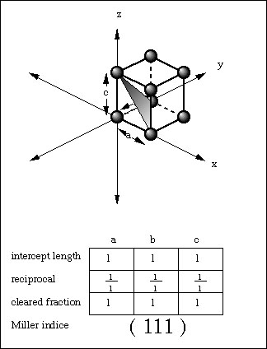
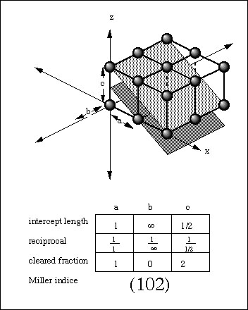
EXAMPLES TO FIND MILLER INDICES
(111)
(102)

Slide 10
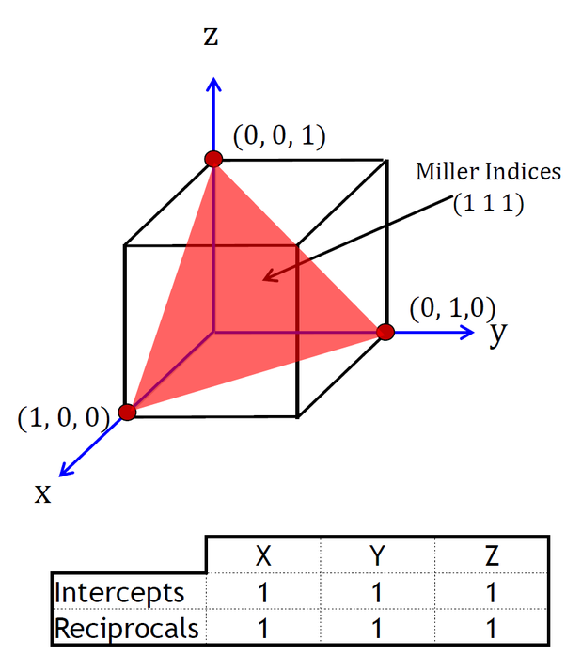
Another way to show [111] plane
Q Try to draw [222] plane?

Slide 11
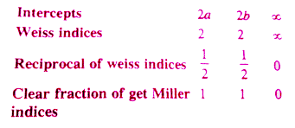
Relation between Weiss and Miller Indices.

Slide 12
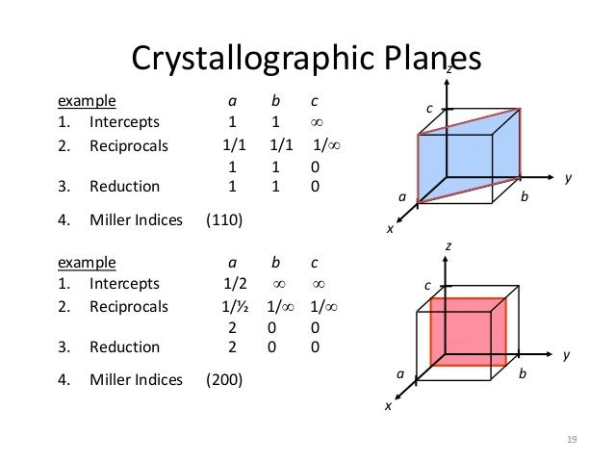
Designating Crystallographic Planes

Slide 13
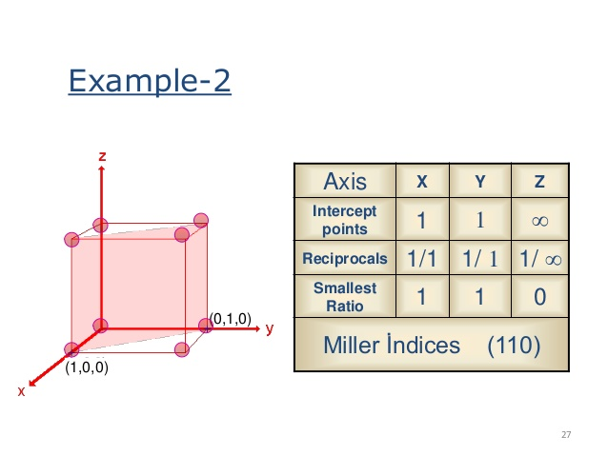
Relation between weiss and miller through example

Slide 14
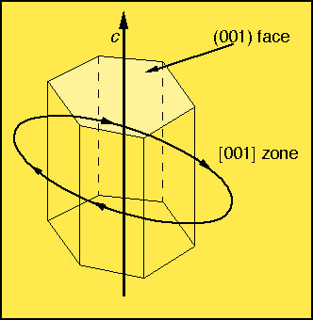
Closures for crystallographics indices
(hkl) = parenthesis designate a crystal face or a family of planes throughout a crystal lattice.
Directions are presented by the three integers uvw. [uvw] = square brackets designate a direction in the lattice from the origin to a point. Used to collectively, they include all the faces of a crystals whose intersects (i.e., edges) parallel each other. These are referred to as crystallographic zones and they represent a direction in the crystal lattice.

Slide 15
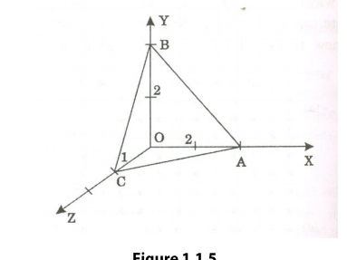
Try to write Miller indices for the above figure
THANX WITH A HOPE THAT YOU WILL TRY TO SOLVE AS MANY PROBLEMS FOR MILLER INDICES AS POSSIBLE WITH DIAGRAM.

Slide 16
Some sites for references
http://clay.uga.edu/courses/8550/millerindices.html
https://chem.libretexts.org

